Slide 1
HepB Calibrations

Slide 2
Current Calibration Heuristic (Nov 2022)
Adjustables | Measurables
Sag_ix, ad_pop_sus, ch_pop_sus, eag_ix | Prev
M_acu | Cl_acu
It_icl, icl_ict | Eag_ott
U_tx_cov | Treat_covt
M_dc | Cl_cir
M_hcc | Cl_hcc

Slide 3
What to look out for in calibrations
How close are we to the data?
How reasonable are the y_factors?
How much further manual work is needed for a suitable calibration?

Slide 4
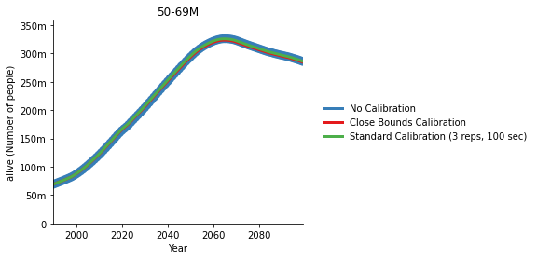
Comparison of Results - Population
All Population Calibrations are really close to the data

Slide 5
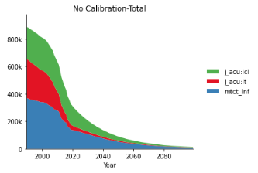
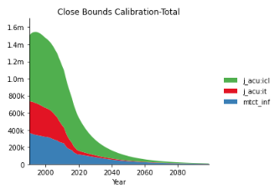
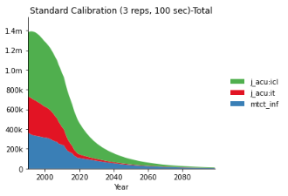
Comparison of Results – Distribution of HepB incidences
Calibration with Tighter y_factor bounds (0.5-2)
Calibration with standard y_factor bounds (0.1-5)
No Calibration

Slide 6
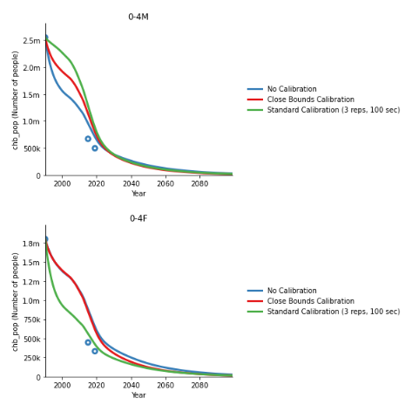
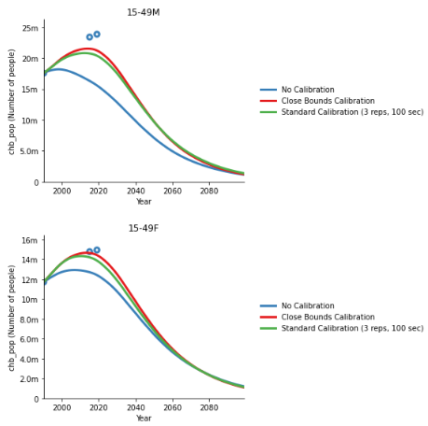
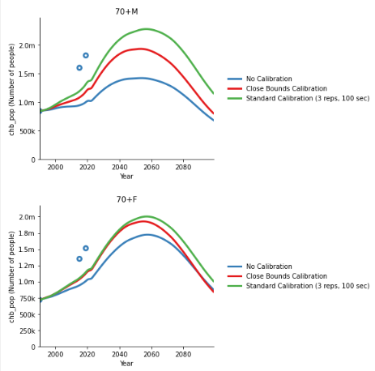
Comparison of Results - Prevalence
Younger age groups are typically overrestimated
Adult groups are generally ‘decently’ calibrated
Older age groups are underestimated

Slide 7
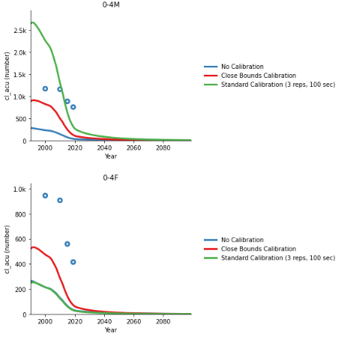
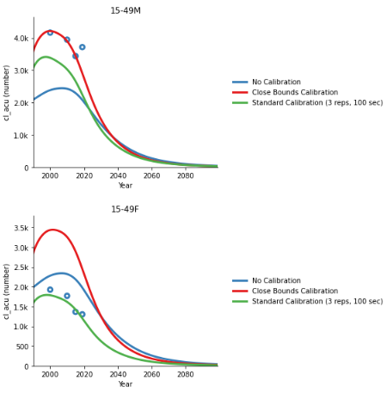
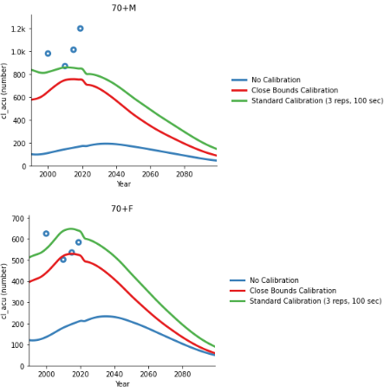
Comparison of Results - Deaths
Acute Deaths
Younger age groups are typically overrestimated
Adult groups are generally ‘decently’ calibrated
Older age groups are underestimated

Slide 8
New Heuristic
GOAL: address the inaccurate death calibration in cirrhosis and hcc
Population Calibration (1x 300s)
Over 4 iterations:
Prevalence via 4 parameters (sag_ix, ad_pop_sus, ch_pop_sus, eag_ix)
Acute-related deaths via acute mortality rate
Eag_ott via it_icl, and icl_ict
Cirrhosis and HepCC deaths via progression from cirrhosis to hcc (cc_dc, dc_hcc)
Cirrhosis deaths via cirrhosis mortality rate
HepCC deaths via HepCC mortality rate

Slide 9
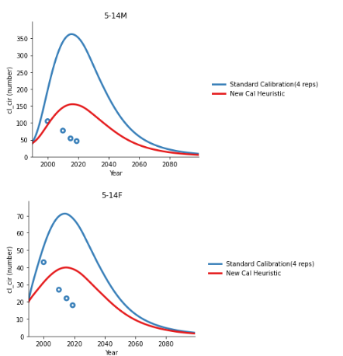
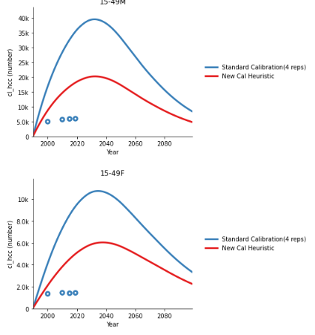
New Heuristic
Cirrhosis deaths
HCC deaths

Slide 10
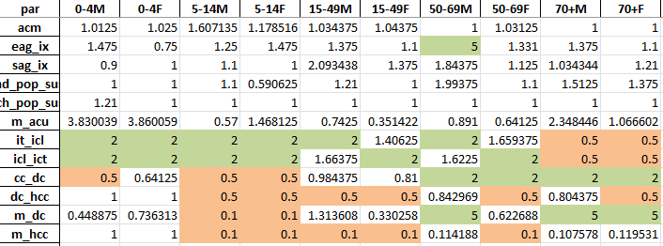
Current Outstanding Issues with the Calibration
Y_factors often reach their upper/lower limit during the calibration stage

Slide 11

Hep B repo Current Status
Old scripts to be archived
Project frameworks (to be added into a separate document)
Pre-made scripts to be added into a separate file
README.md to be updated

